Slide 1
INTERAKSI MANUSIA KOMPUTER (IMK)
Semester Genap 2018-2019

Slide 2
HUMAN COMPUTER INTERACTION (HCI)
ANNY YUNIARTI

Slide 3
HCI
Designing interaction between people and computers
Construct interfaces to afford the interaction
The interaction includes both hardware and software
The interfaces should be designed early at the software life-cycle since the design and implementation of core functionality can influence the user interface (UI)
HCI uses knowledge in psychology, computer science, product design, anthropology and engineering

Slide 4
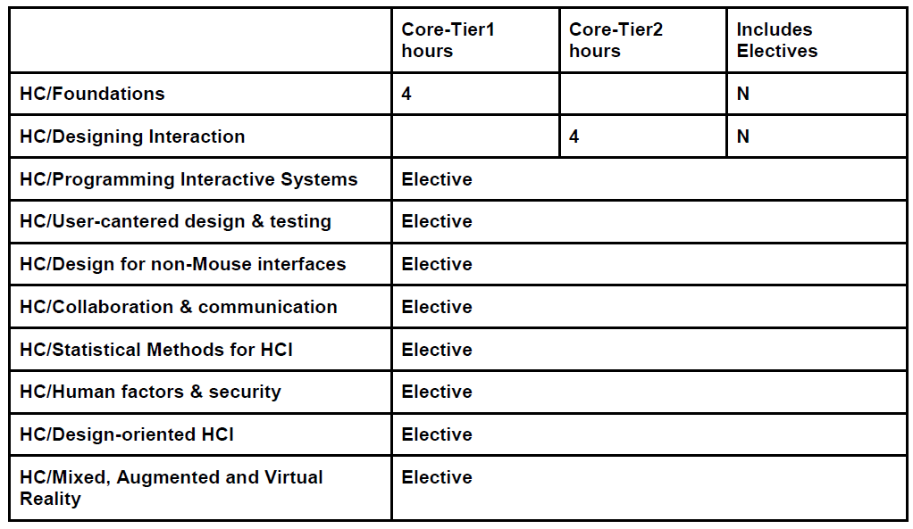
ACM Computing Curricula

Slide 5
IMK sesuai Kurikulum Inf ITS 2018-2023
Mata kuliah wajib semester 6
PRASYARAT: Pemrograman Berorientasi Objek
Deskripsi: IMK berfokus pada proses desain interaksi antara manusia dengan komputer dan pembangunan antar muka untuk melakukan interaksi.
Melalui mata kuliah ini diharapkan mahasiswa mampu menerapkan prinsip- prinsip Interaksi Manusia dan Komputer (Human-Computer Interaction) pada pembuatan perangkat lunak serta melakukan evaluasi ketepatgunaan (Usability Test) perangkat lunak dan melaporkannya.

Slide 6
Capaian Pembelajaran IMK sesuai Kurikulum T.Inf ITS 2018-2023
Mahasiswa mampu mendiskusikan mengapa pengembangan perangkat lunak yang berpusat pada pengguna itu penting.
Mahasiswa mampu memahami aturan/pedoman dasar dalam pengembangan perangkat lunak berikut desain interaksinya dengan mempertimbangkan aspek fisik, psikologi dan sosial pengguna.
Mahasiswa mampu mengembangkan dan menggunakan konsep permodelan, umpan balik untuk menganalisa interaksi antara manusia dengan perangkat lunak.
Mahasiswa mampu mendefinisikan proses desain yang berfokus pada pengguna yang secara eksplisit menempatkan pengguna bukan sebagai pembangun.
Mahasiswa mampu membangun aplikasi sederhana beserta petunjuk penggunaan, serta dokumentasinya yang mendukung antar muka pengguna.
Mahasiswa mampu membuat dan melakukan tes ketepatgunaan (Usability Test) pada perangkat lunak yang telah dikembangkan, melakukan evaluasi secara kuantitatif (utilitas, efisiensi, tingkat kemudahan penggunaan, dan tingkat kepuasan pengguna), dan melaporkannya.
Mahasiswa mampu melaporkan dan mendiskusikan perkembangan teknologi interaksi natural (Natural User Interface) termutakhir: antarmuka sentuh (Multi-touch), antarmuka gerakan (Gesture), antarmuka gelombang otak (Electroencephalography), antarmuka gelombang otot (Electromyography).

Slide 7
Buku Teks dan Pustaka Acuan (dosen: AY)
Alan Dix, Janet E. Finlay, Gregory D. Abowd, and Russell Beale. Human-Computer Interaction (3rd Edition). Prentice-Hall, Inc., Upper Saddle River, NJ, USA. 2004. (Available at RBTC)
Ben Shneiderman and Catherine Plaisant. Designing the User Interface (5th Edition). Addison-Wesley, Mar 2009. (Available at RBTC)
Keith Andrews. Human-Computer Interaction Course Notes. Version of 06 May 2014. (Available online)

Slide 8
Rancangan Pembelajaran IMK (dosen: AY)
 |  | w1 | w2 | w3 | w4 | w5 | w6 | w7 | w8 | w9 | w10 | w11 | w12 | w13 | w14 | w15 | w16
1 | a. Mahasiswa mampu mendiskusikan mengapa pengembangan perangkat lunak yang berpusat pada pengguna itu penting. | Human Computer Interaction [C1]; The Psychology of Usable Things [C2] | The Psychology of Usable Things [C2] |  |  |  |  |  |  |  |  |  |  |  |  | A Brief History of HCI [C13]
2 | b. Mahasiswa mampu memahami aturan/pedoman dasar dalam pengembangan perangkat lunak berikut desain interaksinya dengan mempertimbangkan aspek fisik, psikologi dan sosial pengguna. |  |  | Usability Engineering [C3]; Know the User [C4]
3 | c. Mahasiswa mampu mengembangkan dan menggunakan konsep permodelan, umpan balik untuk menganalisa interaksi antara manusia dengan perangkat lunak. |  |  |  | Usability Benchmarking [C5]; Quiz1
4 | d. Mahasiswa mampu mendefinisikan proses desain yang berfokus pada pengguna yang secara eksplisit menempatkan pengguna bukan sebagai pembangun. |  |  |  |  | Goal-Oriented Interaction Design [C6] | Goal-Oriented Interaction Design [C6] |  |  |  |  |  |  | Visual Design and Typography [C11] | Icon Design [C12]
5 | e. Mahasiswa mampu membangun aplikasi sederhana beserta petunjuk penggunaan, serta dokumentasinya yang mendukung antar muka pengguna. |  |  |  |  |  | Prototyping [C7] | Prototyping [C7]
6 | f. Mahasiswa mampu membuat dan melakukan tes ketepatgunaan (Usability Test) pada perangkat lunak yang telah dikembangkan, melakukan evaluasi secara kuantitatif (utilitas, efisiensi, tingkat kemudahan penggunaan, dan tingkat kepuasan pengguna), dan melaporkannya. |  |  |  |  |  |  |  |  | Usability Inspection Methods [C8] | Usability Testing Methods [C9] | Usability in Practice [C10]
7 | g. Mahasiswa mampu melaporkan dan mendiskusikan perkembangan teknologi interaksi natural (Natural User Interface) termutakhir: antarmuka sentuh (Multi-touch), antarmuka gerakan (Gesture), antarmuka gelombang otak (Electroencephalography), antarmuka gelombang otot (Electromyography).

Slide 9
Peraturan Akademik ITS 2014
Pasal 25 Rencana Pembelajaran
(1) Mahasiswa berhak mendapatkan rencana pembelajaran untuk setiap mata kuliah yang diikuti pada awal semester.
(2) Pembelajaran dapat terdiri dari perkuliahan, responsi, seminar, tugas, praktikum/studio, dan asesmen/evaluasi pembelajaran yang wajib diikuti oleh setiap mahasiswa.
(3) Mahasiswa berhak mendapatkan pembelajaran sekurang-kurangnya 90 persen dari yang dijadwalkan dalam satu semester.
(4) Mahasiswa yang tidak mengikuti pembelajaran melebihi 20 persen dari jumlah yang diselenggarakan dalam satu semester, mata kuliah yang diikutinya dinyatakan gagal dengan nilai E.
(5) Pengecualian dari ayat (4) diberikan kepada mahasiswa yang sedang melaksanakan kegiatan akademik/kemahasiswaan dengan seijin pimpinan ITS, atau yang sakit dengan menunjukkan surat keterangan resmi dari dokter

Slide 10
Jadwal dan Kontak
Kelas B: Senin 07.30-10.00 di IF 107b
Kelas C: Kamis 07.30-10.00 di IF 107b
Kontak Dosen:
anny@if.its.ac.id
Asisten:
Kelas B dan C: Renaldi

Slide 11
Any Questions?

Slide 12
What is HCI?
“ Human-computer interaction is a discipline concerned with the design, evaluation and implementation of interactive computing systems for human use and with the study of major phenomena surrounding them. ”
[ ACM SIGCHI Curricula for Human-Computer Interaction [Hewett et al., 2002, page 5] ]

Slide 13
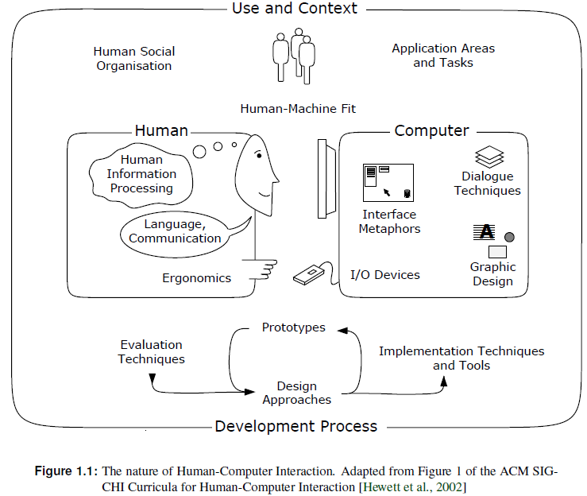

Slide 14
The Psychology of Usable Things
“When simple things need pictures, labels, or instructions, the design has failed. ”
[Don Norman, The Design of Everyday Things, 1988]

Slide 15
The Frustrations of Everyday Life
Can you use all the functions of your:
digital watch?
mobile phone?
washing machine?
video recorder?

Slide 16
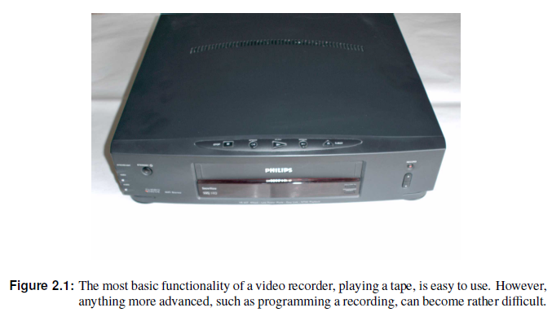
The Frustrations of Everyday Life

Slide 17
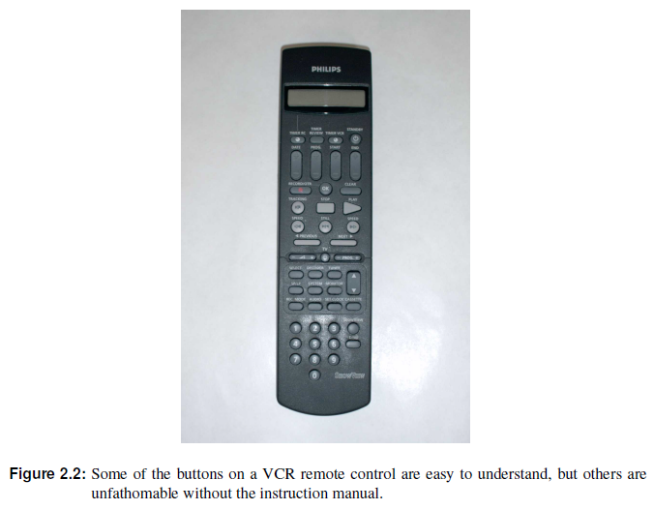

Slide 18
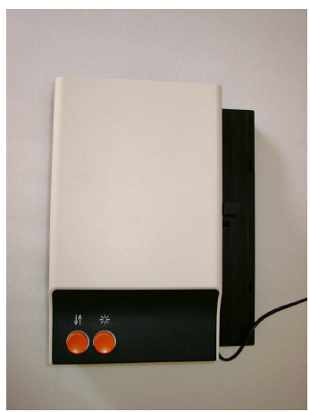
Zeiss Slide Projector
Only one button to control the slide advance.
During lectures, sometimes the slides go forwards, sometimes they go backwards . . .
If you can find an instruction manual:
Short press = forward, long press = backward.
What an elegant design, two functions with just one button!
But how should first-time users know what to do?

Slide 19
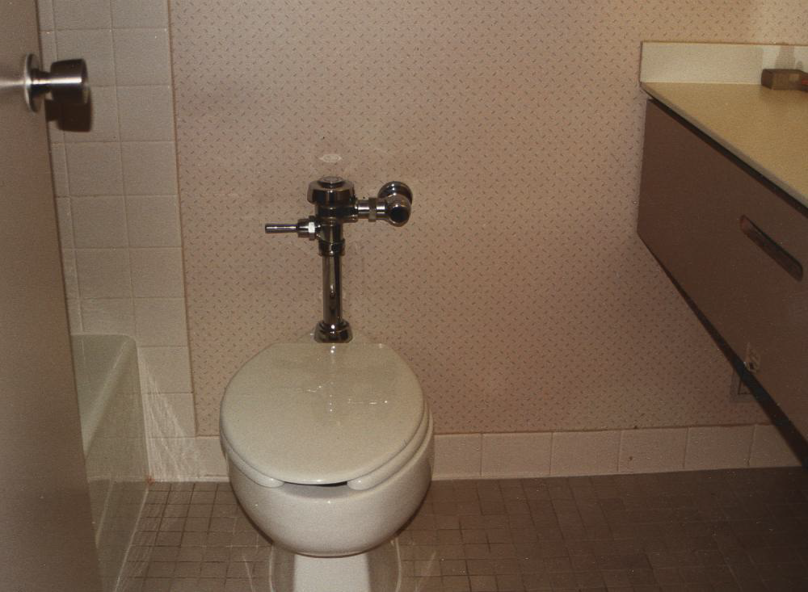
Where is the Toilet Paper?
Fancy hotel, nice bathrooms
Having sat down and done the business, where the heck is the toilet paper?

Slide 20
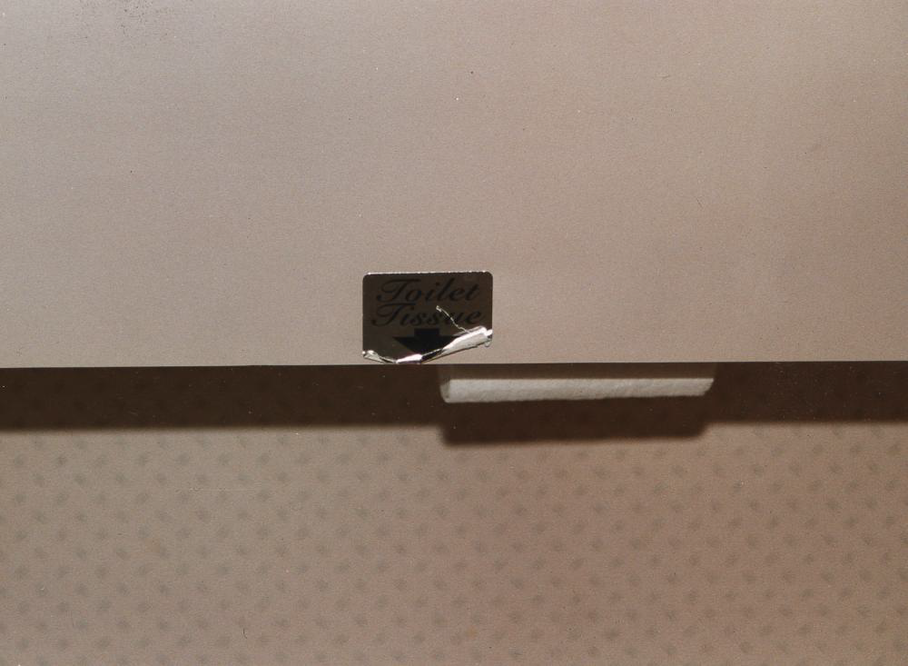
Where is the Toilet Paper?
The toilet paper is well-hidden under the ledge, and is impossible to find without the sign.

Slide 21
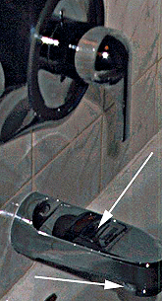
Shower Control
Shower control: water either goes into the bath out of the faucet or comes out of the shower.
Sticker with instructions on the faucet.
How do you make the water come out of the shower instead of the faucet?
You have to reach under the faucet and pull the knob down!

Slide 22
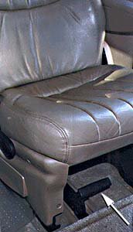
Car Seat
A seat in a mini-van (people carrier).
What do you think happens when you pull the lever under the seat?
Most normal-thinking people would expect the seat to slide backward or forward.
Not in this mini-van. Pulling the lever detaches the seat from the floor to make room for cargo!

Slide 23
More Examples
Michael Darnell; Bad Human Factors Designs; http://baddesigns.com/
Mark Hurst; This is broken; http://goodexperience.com/tib/
Computer Stupidities; http://www.rinkworks.com/stupid/
Web Pages That Suck; http://webpagesthatsuck.com/

Slide 24

Section 2: The Psychology of Everyday Things
Kuliah IMK 2019

Slide 25
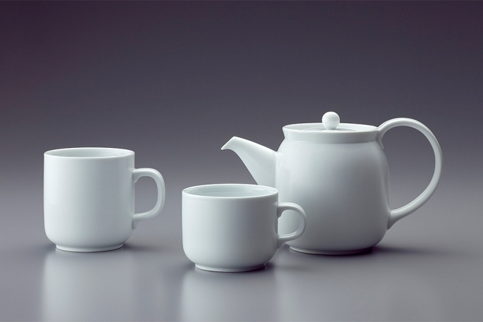
Perceived and Real Affordances
Affordances are the range of possible (physical) actions by a user on an artefact:
Perceived Affordances are the actions a user perceives to be possible.
Real Affordances are the actions which are actually possible.
The handles on a tea set provide an obvious affordance for holding for individuals with hands.

Slide 26
Real World Affordances
For physical objects, there can be both real and perceived affordances (and the two sets are not necessarily the same).
Appearance indicates how to use something:
A chair affords (suggests) sitting.
Knobs are for turning.
Slots are for inserting things.
A button affords pushing.
When perceived affordances are taken advantage of, the user knows what to do just by looking.

Slide 27
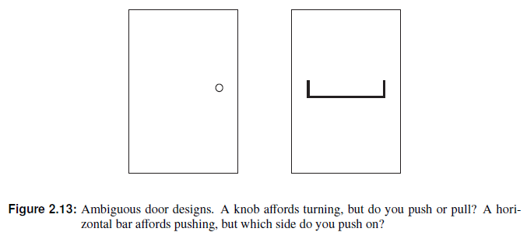

Slide 28
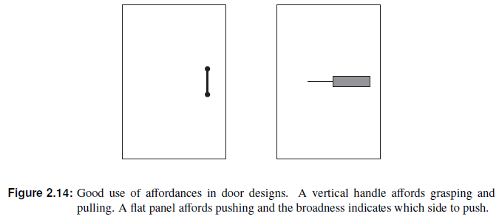

Slide 29
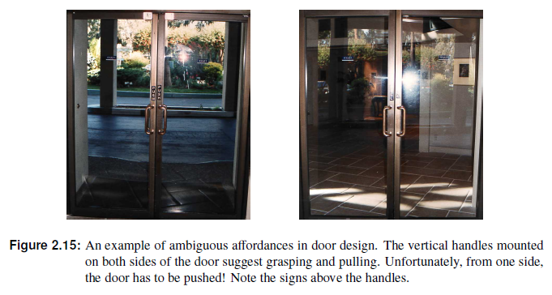

Slide 30
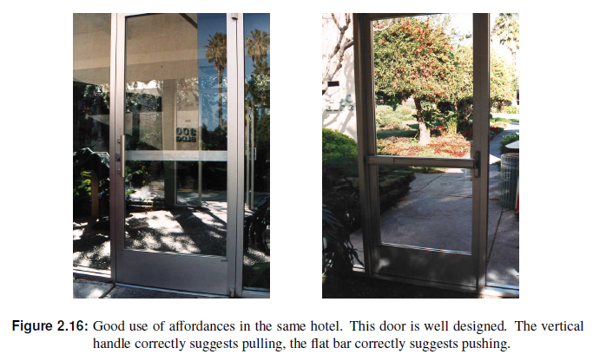

Slide 31
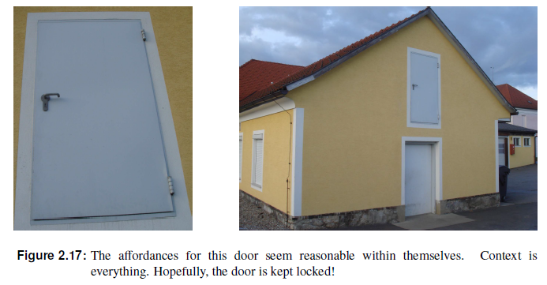

Slide 33
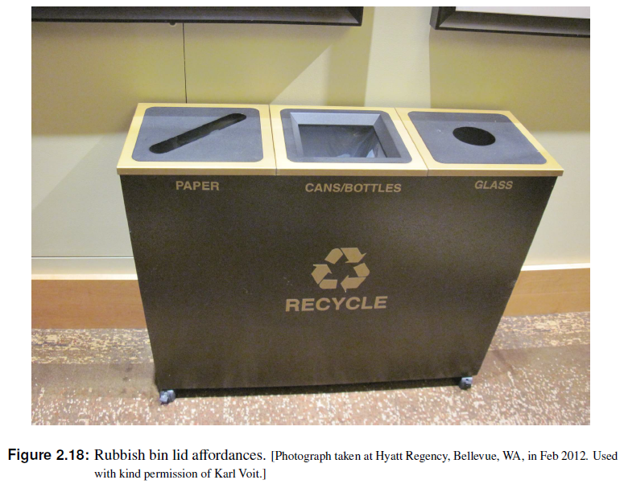

Slide 34
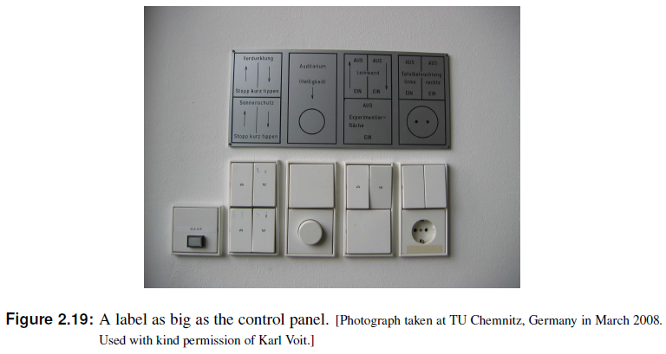
Labels
“When simple things need pictures, labels, or instructions, the design has failed!”

Slide 35
GUI Affordances
For screen-based interfaces, the computer hardware already has built-in physical aordances:
Screen affords touching.
Mouse affords pointing.
Mouse buttons afford clicking.
Keyboard affords typing.
Changing the shape of the cursor to indicate a clickable link is not an affordance (you can still click anywhere), but visual feedback.
Physically locking the mouse button on non-clickable areas is a real affordance.

Slide 36
Mappings
Mappings are the relationships between controls and their effects on a system.
Natural mappings take advantage of physical analogies and cultural standards.
Examples:
Turn steering wheel clockwise to turn a car right. Actually, there are two mappings here:
which control affects steering,
which direction to turn it.
Move a control up to move an object up.
Use a louder sound to mean a greater amount.

Slide 37
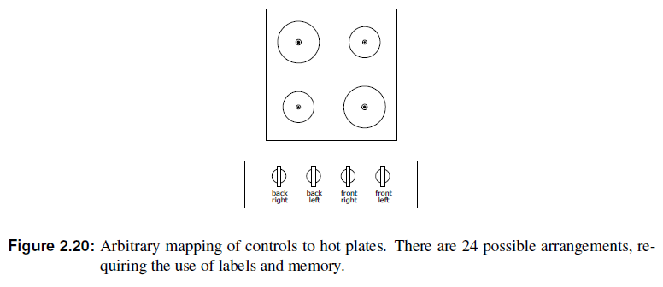
How should one arrange the hot plate controls on a cooker?

Slide 38
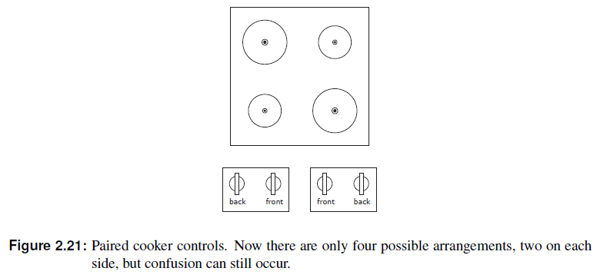
How should one arrange the hot plate controls on a cooker?

Slide 39
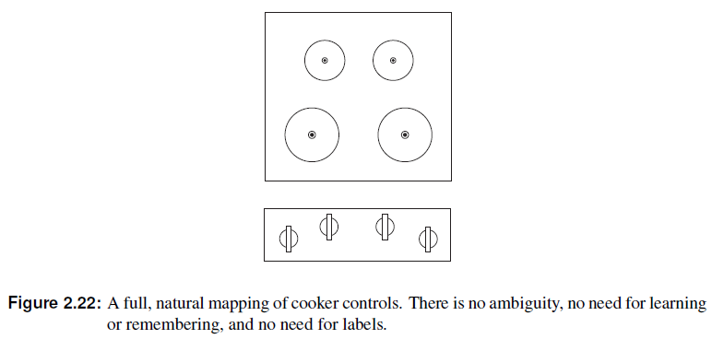
How should one arrange the hot plate controls on a cooker?

Slide 40
Constraints
The difficulty of dealing with a novel situation is directly related to the number of possibilities.
Constraints are physical, semantic, cultural, and logical limits on the number of possibilities.
Physical constraints such as pegs and holes limit possible operations.
Semantic constraints rely upon our knowledge of the situation and of the world.
Cultural constraints rely upon accepted cultural conventions.
Logical constraints exploit logical relationships. For example a natural mapping between the spatial layout of components and their controls.
Where affordances suggest the range of possibilities, constraints limit the number of alternatives.

Slide 41
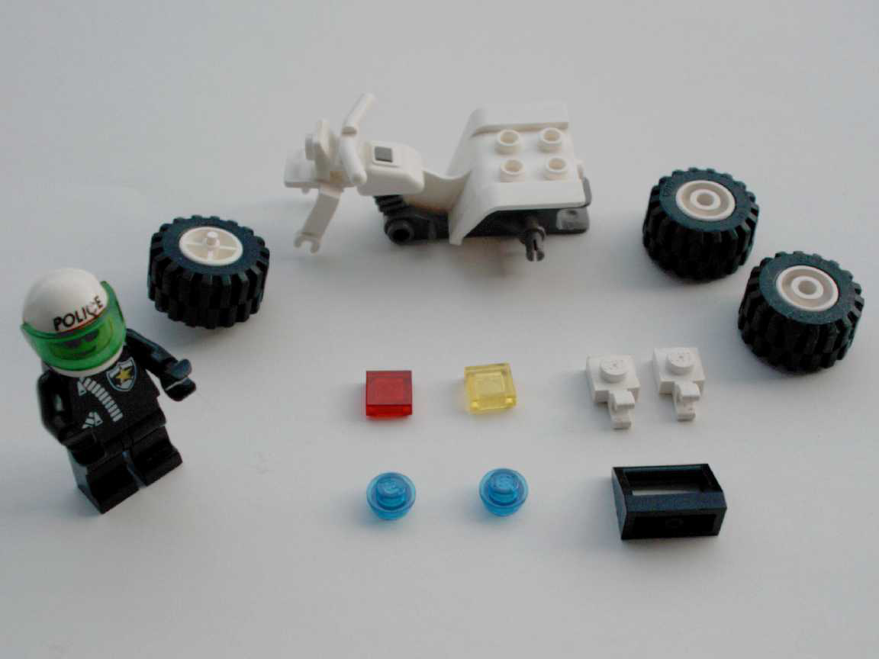
Constraints in Lego Motorbike
Motorbike toy with 12 parts. Constraints make its construction simple, even for adults!
Physical: Front wheel only fits in one place.
Semantic: The rider sits on the seat facing forward.
Cultural: Red is a rear light, yellow a front light.
Logical: Two blue lights, two white pieces, probably go together.
The design takes advantage of constraints to make its construction simple.

Slide 42
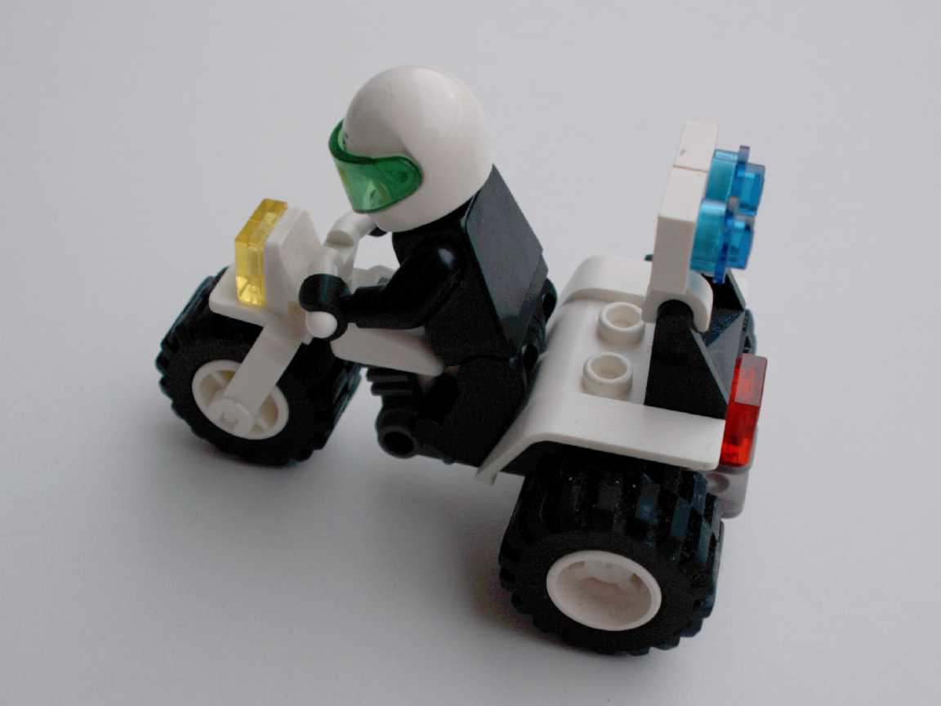
Constraints in Lego Motorbike
Motorbike toy with 12 parts. Constraints make its construction simple, even for adults!
Physical: Front wheel only fits in one place.
Semantic: The rider sits on the seat facing forward.
Cultural: Red is a rear light, yellow a front light.
Logical: Two blue lights, two white pieces, probably go together.
The assembled lego motorbike

Slide 43
Conventions
Conventions are cultural constraints. They are initially arbitrary, but evolve and become accepted over time.
They can however still vary enormously across different cultures, for example:
Light switches:
America down is off
Britain down is on
Water taps:
America anti-clockwise is on
Britain anti-clockwise is off
The colour red:
America danger
Egypt death
India life
China happiness

Slide 44
The Principle of Causality
Causality is the relation between two events, cause and effect, where the second occurs as a consequence of the first.
Apparent causality is when something which happens immediately after an action, appears to have been caused by that action. We associate the effect with the apparent cause.

Slide 45
The Principle of Causality
There are two kinds of false causality:
Coincidental effects lead to superstition:
Touch a computer terminal just before it fails, and you are apt to believe you caused the failure.
Start an unfamiliar application, just before the computer crashes.
Invisible effects lead to confusion:
When an action has no apparent result, you may conclude it was ineffective (and repeat it).
For example, repeatedly clicking the “Stop” button when the system is unresponsive.
There is a need for feedback!

Slide 46
The Structure of Human Memory
Short-Term Memory (STM)
Short-term memory is the memory of the present, used as working or temporary memory.
Information is retained in STM automatically and is retrieved without effort.
However, the amount of information in STM is severely limited: 7 ± 2 items
STM is extremely fragile – the slightest distraction and its contents are gone.
For example, STM can hold a seven digit phone number from the time you look it up until the time you use it, as long as no distractions occur.

Slide 47
The Structure of Human Memory
Long Term Memory (LTM)
Long-term memory is the memory of the past.
It takes time to put stuff into LTM and time and effort to get stuff out.
Capacity is estimated at about 100 million items.
Knowledge in the Head and in the World
Not all of the knowledge required for precise behaviour has to be in the head. It can be distributed:
partly in the head
partly in the world
and partly in the constraints of the world.

Slide 48
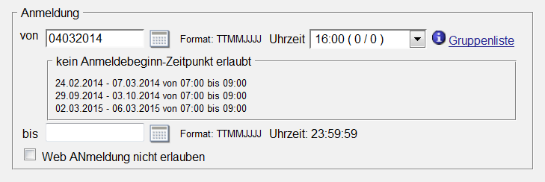
The Structure of Human Memory
Placing Knowledge in the World
Having knowledge in the world reduces the load on human memory:
An example of the input format can be provided in the interface:
Please enter the date (yyyy/mm/dd):
The intranet server at Graz University of Technology, TUGrazOnline, provides an
example of the expected date format (TTMMJJJJ) in the interface next to the input
field. Users do not have to remember the required format.

Slide 49
The Structure of Human Memory
Placing Knowledge in the World
Having knowledge in the world reduces the load on human memory:
Previously entered values can be used as defaults, so users do not have to remember items between screens.
It is better if the designers of an interface place knowledge in the world.
However, sometimes, users have to place knowledge in the world themselves to fix a broken interface.
Wherever possible, also allow expert users to internalise knowledge for faster and more efficient performance (say by learning to type a date in a particular format, rather than having to use the provided calendar widget).

Slide 50

The Structure of Human Memory
Shape Coding for Aircraft Control Knobs
During the first years of World War 2, there were dozens of gear-up accidents when landing B-17, B-25, and P-47 aircraft.
Pilots frequently retracted the landing gear instead of the flaps after landing.
The B17 Flying Fortress

Slide 51
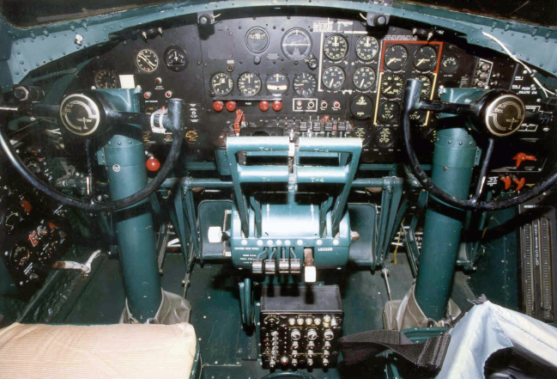
The Structure of Human Memory
Shape Coding for Aircraft Control Knobs
In 1943, Lt. Alphonse Chapanis was ordered to investigate and noticed that C-47 transport (DC3 Dakota) pilots suffered no such accidents.
In the B-17, the control knobs for flaps and landing gear were identical and located close to one another.
The cockpit of a B17G Flying Fortress. The landing gear and flaps control knobs are
identical and are very close to one another.

Slide 52
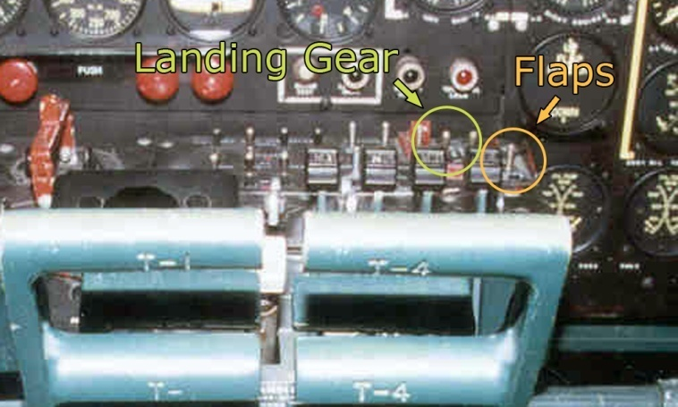
The Structure of Human Memory
Shape Coding for Aircraft Control Knobs
In 1943, Lt. Alphonse Chapanis was ordered to investigate and noticed that C-47 transport (DC3 Dakota) pilots suffered no such accidents.
In the B-17, the control knobs for flaps and landing gear were identical and located close to one another.
Close-up of the cockpit control knobs of a B17G Flying Fortress. The landing gear
and flaps control knobs are identical and are very close to one another.

Slide 53
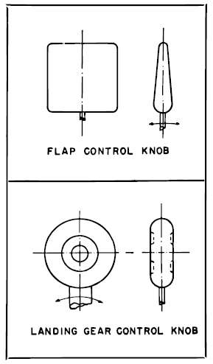
The Structure of Human Memory
Shape Coding for Aircraft Control Knobs
In the C-47, the flaps control was totally separate and was activated like a modern car handbrake.
Chapanis realised that so-called “pilot errors” were really “designer errors”
As a quick fix, a small rubber wheel was attached to the end of the landing gear control and a wegde shape to the flap control.
The gear-up landings ceased.
After the war, the shape-coded wheel and flap controls were standardised and are still used today.

Slide 54
The Structure of Human Memory
To Err is Human
People make errors routinely, you must design for error.
Assume that any error, that can be made, will be made!
Design explorable systems, where operations are easy to reverse.
Categories of Error
Two fundamental categories of error:
Slips result from automatic behaviour, when subconscious actions toward a correct goal go wrong.
Mistakes result from conscious deliberations, which formed an inappropriate goal.

Slide 55
Conceptual Models
A conceptual model is a mental model of how something works, which is formed inside a person’s head.
A user’s conceptual model built up and influenced by numerous factors, including:
familiarity with similar devices (transfer of previous experience)
affordances
mapping
constraints
causality
instructions
interacting with the device.
Conceptual models may be wrong, particularly if the above factors are misleading.

Slide 56
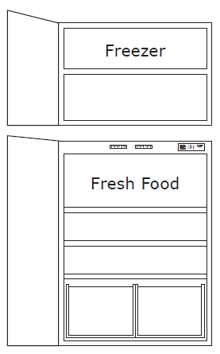
A Conceptual Model of a Fridge Freezer
A fridge-freezer with two compartments: the fridge for fresh food at the bottom and the freezer for frozen goods at the top

Slide 57
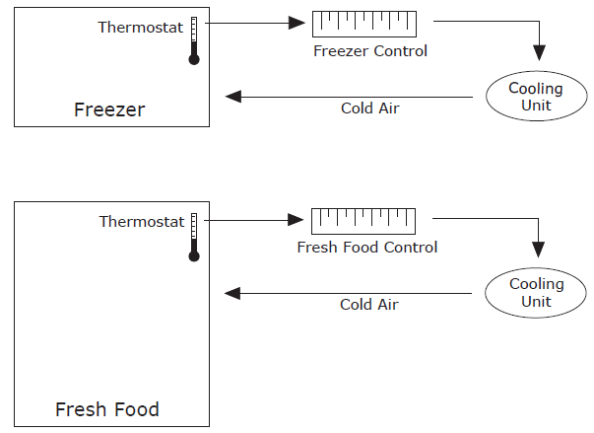
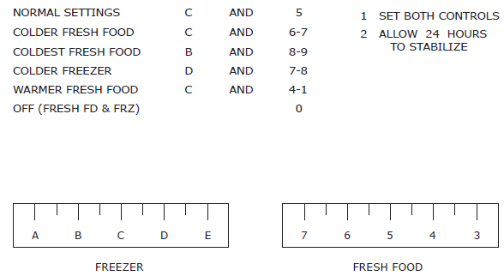
A Conceptual Model of a Fridge Freezer
The fridge freezer controls and instructions:
The apparent conceptual model for the fridge freezer, gleaned from the controls and instructions, is that each control is responsible for the temperature of the corresponding compartment.

Slide 58
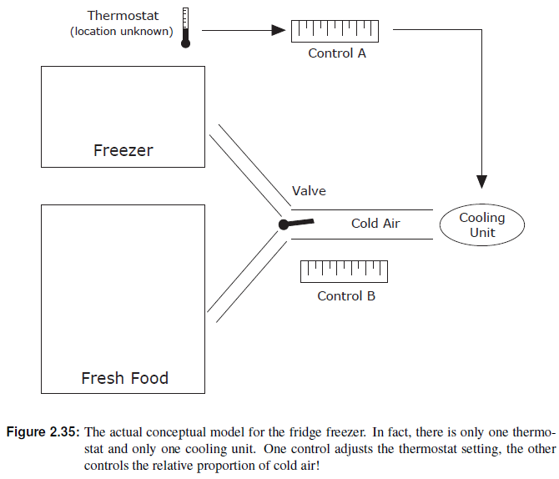
Unfortunately, the apparent conceptual model does not match the way the fridge freezer actually
works

Slide 59
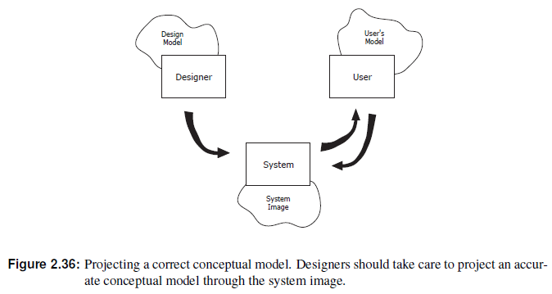
Projecting a Correct Conceptual Model
Designers have their own conceptual model of a system, the design model.
The system image is the actual implementation or embodiment of the design (including documentation, instructions, and labels).
The user’s model is built through interaction with the system.
The designer expects the user’s model to be the same as the design model, however all communication takes place through the system image.
The system image should make the design model clear and consistent.

Slide 60
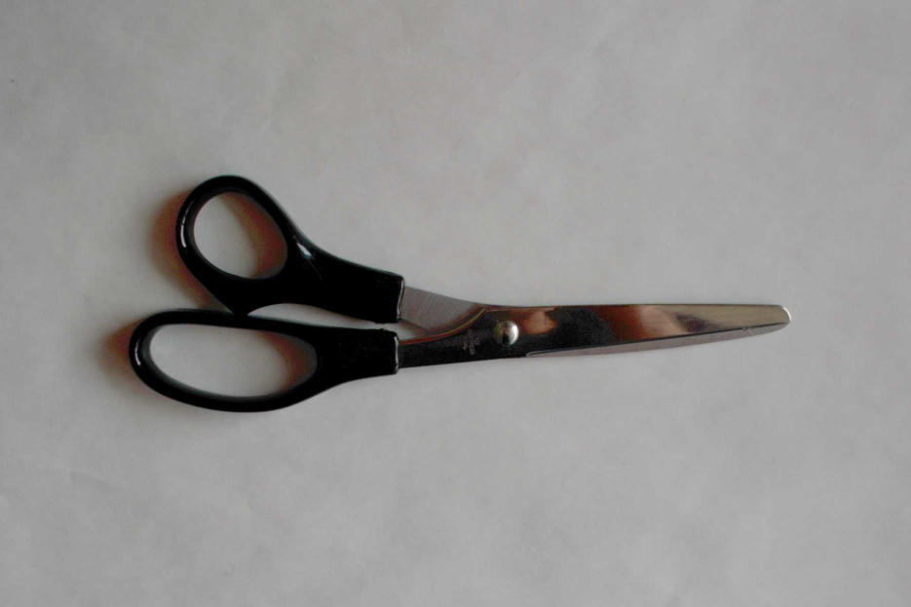
A Pair of Scissors Projects a Good Conceptual Model
Affordances: holes for putting fingers in.
Constraints: small hole for thumb, big hole for several fingers.
Mapping: between holes and fingers suggested and constrained by appearance.
Conceptual Model: operating parts are visible and their implications are clear.

Slide 61
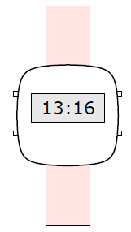
A Digital Watch Projects No Visible Conceptual Model
Affordances: four buttons to push – but what do they do?
Mapping: no clear relationship between buttons and possible actions.
Transfer of Prior Knowledge: little similarity to analog watches.
Conceptual Model: must be learnt from instructions.

Slide 62
The Psychopathology of Computers: Usability “war stories” concerning computers . . .
The PC Cup Holder
A supposedly true story from a Novell NetWire SysOp:
Caller : “Hello, is this Tech Support?”
Tech Rep : “Yes, it is. How may I help you?”
Caller : “The cup holder on my PC is broken and I am within my warranty period. How do I go about getting that fixed?”
Tech Rep : “I’m sorry, but did you say a cup holder?”
Caller : “Yes, it’s attached to the front of my computer.”
Tech Rep : “Please excuse me if I seem a bit stumped, it’s because I am. Did you receive this as part of a promotional, at a trade show? How did you get this cup holder? Does it have any trademark on it?”
Caller : “It came with my computer, I don’t know anything about a promotional. It just has ’4X’ on it.”
At this point the Tech Rep had to mute the caller, because he couldn’t stand it. The caller had been using the load drawer of the CD-ROM drive as a cup holder, and snapped it off the drive.
This story was found at Greenberg, 1997 and is attributed there to George Wagner g.wagner@sylvania.sev.org.

Slide 63
The Psychopathology of Computers: Usability “war stories” concerning computers . . .
Dangerous Command Names
A widely used text editor (ed) used the character ’.’ to select the current line of text, and ’,’ to select the entire document for an operation.
These two keys are adjacent on the keyboard → highly likely they will sometimes be mistaken.
 Intending to change one line
“A heavy poll is expected . . . ”
to
“A heavy turnout is expected . . . ”
can easily change ’poll’ to ’turnout’ throughout the entire document.
 Such a case was reported in the British press: all the election documents of a candidate named Pollack were printed with the name Turnoutack.
 A “computer failure” was blamed.
This story is taken from [Newman and Lamming, 1995], pages 8–9.

Slide 64
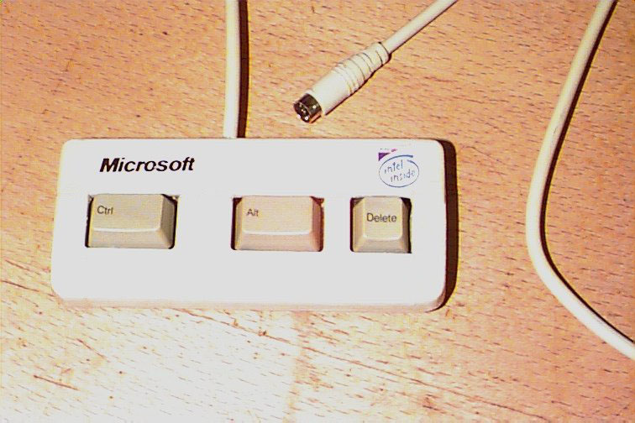
The Psychopathology of Computers: Usability “war stories” concerning computers . . .
And Finally. . .
A new keyboard designed to speed up access to the most commonly used feature on Windows PCs.
[From the enemy.org web site http://www.enemy.org/gallery/devices.shtml, which no longer exists.]

Slide 65
The Psychopathology of Computers: Usability “war stories” concerning computers . . .
Lessons
Most failures of human-machine systems are due to poor designs which do not take account of peoples’ capabilities and fallibilities.
These are often labeled as “computer failure” or “human error” rather than design failure.

Slide 66
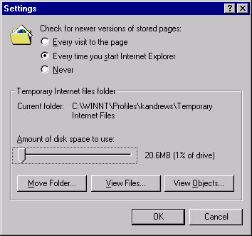
Interface Hall of Shame
Smallest Setting is 1%
The Internet Explorer 4.0 cache size can only be set in increments of 1% of the size of the hard disk
To quote from user Ross Cormier:
“The smallest setting is 1%. I have a 4 Gig drive, and don’t need 40 MB of cache thank you.”
Internet Explorer 4.0 cache settings panel.

Slide 67
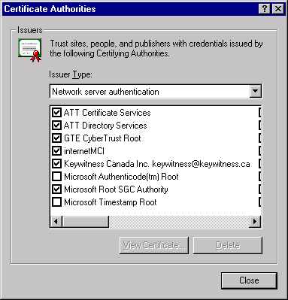
Interface Hall of Shame
Horizontal Scrolling
Humans can scan written material faster from top to bottom rather than left to right.
Vertically scrolling lists support single-item scrolling.
The Internet Explorer 4.0 certificate authority selection panel uses horizontal scrolling
Internet Explorer 4.0 certificate authority selection panel.

Slide 68
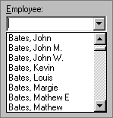
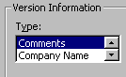
Interface Hall of Shame
Two Item List Box
Visual Basic 5.0 uses a two (!) item list box.
A drop down list or radio buttons would be much better
Two Thousand Item List Box
Do not put hundreds or thousands of items into a list box, either
The following message, posted in a Visual Basic programmers forum on 11th December 1996, is typical:
“I want to fill a list box with 2000 items ... This takes incredibly long ... over 20 minutes. Any ideas?”

Slide 69
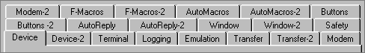
Interface Hall of Shame
Multi-Row Property Sheets
Single-row property sheets (tab controls) are among the best user interface elements ever devised.
Multi-row tab controls are perhaps one of the worst interface elements ever!
Clicking one of the tabs other than from the bottom row, causes a major re-organisation of the complete set of tabs.
Zoc, a communications program, uses multi-row tab controls

Slide 70
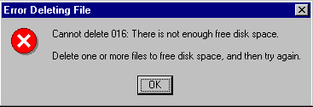
Interface Hall of Shame
Stupid Error Messages
Roy Child writes:
“I came across this message when trying to delete files from a nearly-full hard drive in Windows 95.
Deleting files from an almost full hard disk in Windows 95.
OK, now I know what to do!

Slide 71
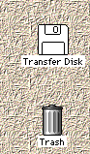
Interface Hall of Shame
Avoid Breaking a Metaphor
As a means of deleting files and documents, the Macintosh trash can is a perfectly intuitive metaphor.
Unfortunately, the designers decided to extend the trash can metaphor to include the completely counterintuitive function of ejecting diskettes.
To eject a diskette, the user had to drag the diskette icon and drop it into the trash!
Ejecting a diskette on the Mac by throwing it into the trash unfortunately breaks the trash can metaphor

Slide 72
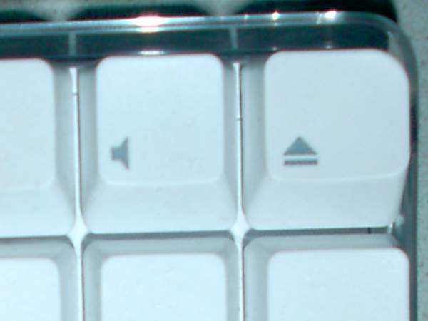
Interface Hall of Shame
Avoid Breaking a Metaphor
Later versions of the Mac keyboard have a dedicated eject button

Slide 73
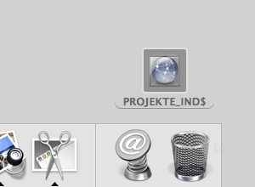
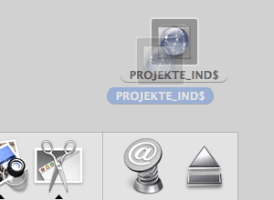
Interface Hall of Shame
Avoid Breaking a Metaphor
The interface was finally fixed in Mac OS X. When the user drags a diskette icon, the trash icon morphs into an eject icon.

Slide 74
User-Centered Design
System-Centered Design
User-Centered Design
Science Finds, Industry Applies, Man Conforms.
[Motto of 1933 Chicago World’s Fair]
People Propose, Science Studies, Technology Conforms.
[Don Norman’s person-centered motto for 21st century]

Slide 75
System-Centered Design
What can be built easily on this platform?
What can I create from the tools available?
What do I as a developer find interesting to work on
What do I as a developer think users need??

Slide 76
User-Centered Design
The design is based upon a user’s:
abilities and needs
context
work
tasks

Slide 77
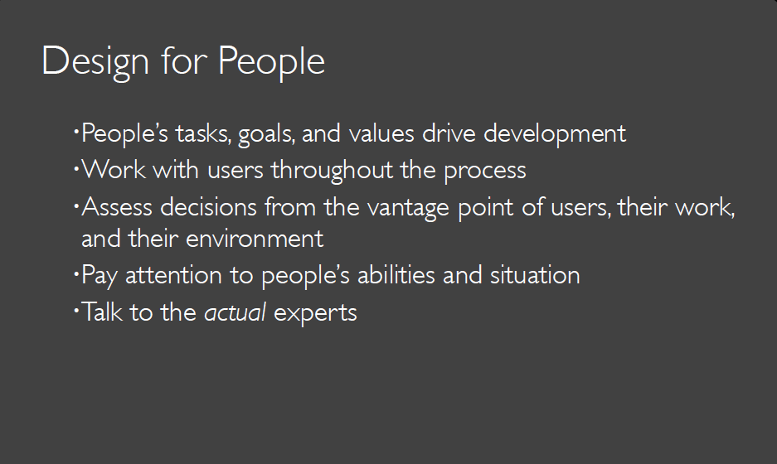

Slide 78
User-Centered Design
A user-centered design process provides a professional resource to creating software with functionality that users need.
However, the availability of technical functionality does not guarantee that software will be practically usable.
Software that is usable for its purpose is sometimes described by programmers as “intuitive” (easy to learn, easy to remember, easy to apply to new problems) or “powerful” (efficient, effective).
The HCI course presents scientific approaches to making software that is “intuitive” and “powerful”.

Slide 79
User-Centered Design
HCI helps us to understand why some software products are good and other software is bad.
But sadly it is not a guaranteed formula for creating a successful product.
In this sense it is like architecture or product design.
Architects and product designers need a thorough technical grasp of the materials they work with, but the success of their work depends on the creative application of this technical knowledge.
This creativity is a craft skill that is normally learned by working with a master designer in a studio, or from case studies of successful designs.
A computer science course does not provide sufficient time for this kind of training in creative design, but it can provide the essential elements: an understanding of the user’s needs, and an understanding of potential solutions.

Slide 80

Video: Simplicity Sells

Slide 81
Discussion 1
Suggest ideas for an interface which uses the properties of sound effectively
think how sound could be added to an application with which you are familiar.

Slide 82
Discussion 2
Devise experiments to test the properties of (i) short-term memory (ii) long-term memory
Try out your experiments on your friends.
Are your results consistent with the properties described?

Slide 83
Discussion 3
Identify the goals and operators involved in the problem ‘delete the second paragraph of the document’ on a word-processor.
Now use a word-processor to delete a paragraph and note your actions, goals and sub-goals.
How well did they match your earlier description?

Slide 84
Exercise
Observe skilled and novice operators in a familiar domain, for example, touch and ‘hunt-and-peck’ typists, expert and novice game players, or expert and novice users of a computer application.
What differences can you discern between their behaviors?
This is an exercise in observation. You should think about skill acquisition, proceduralization, chunking etc.
Is there any evidence of this in practice?
How do the groups differ (speed, error, style, strategy)?
Do the differences suggest different skill levels?

